Slide 1
Paleoindian
Eric Olson​​
Notes:
Paleoindian is the commonly used term to describe the cultures that first colonized North America at the end of the last glaciation of the world (Pleistocene). Scholars currently are debating the age of first colonization, but most agree that the Paleoindian ended with the deaths of ice age mammals like mammoths, giant sloth, and mastodons.

Slide 2
First People
Debated concepts:
When?
Who?
Subsistence?
Technology?
Notes:
The Paleoindian period is one of the most scrutinized and hotly debated within North American archaeology. Generally, these debated concepts center around four areas: when did people first arrive in the Americas, who arrived, what was their subsistence system like, and what kind of technology did they have?

Slide 3
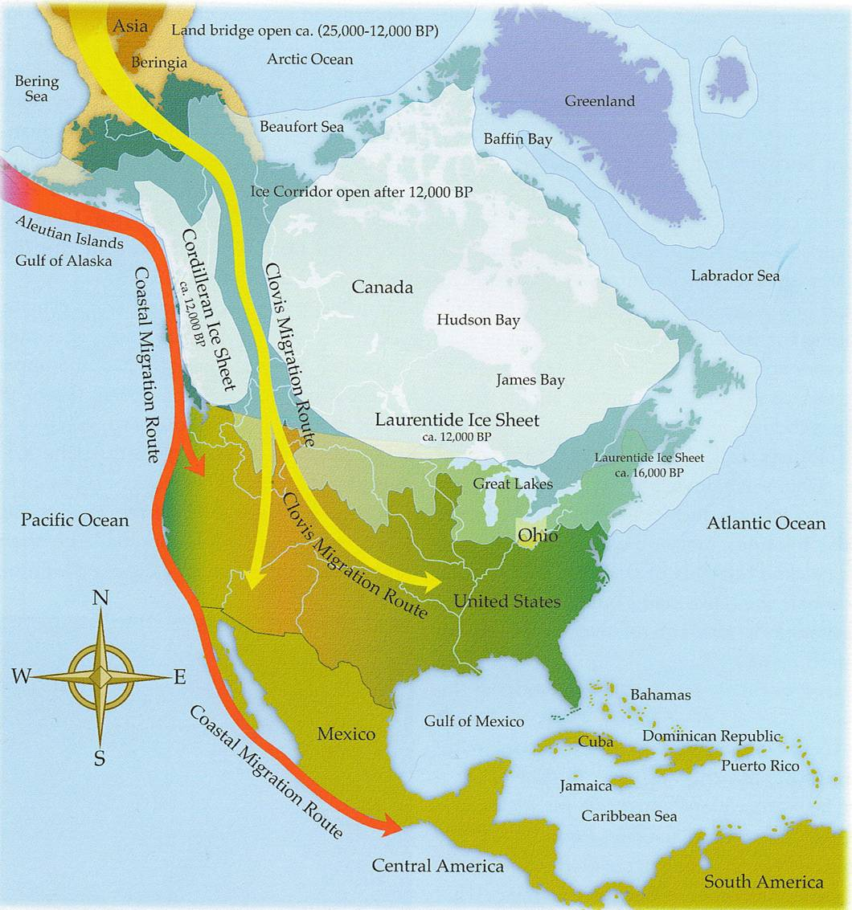
When?
Glaciers
Land Bridges
Ice Corridors
Notes:
Understanding the human colonization of the Americas requires a working knowledge of glacial geology. Glaciers greatly altered the landscape of all of Canada and portions of the United States. But with so much ice, the sea levels of the Earth were much lower than they are today, since much of the water we have today is liquid. This lower sea level meant that what are today isolated landmasses were connected by land bridges. This is one of the ways humans reached Australia and parts of southeast Asia, but it is also one of the primary ways humans traveled to the Americas, across the Bering land bridge, also known as “Beringia.”

Slide 4
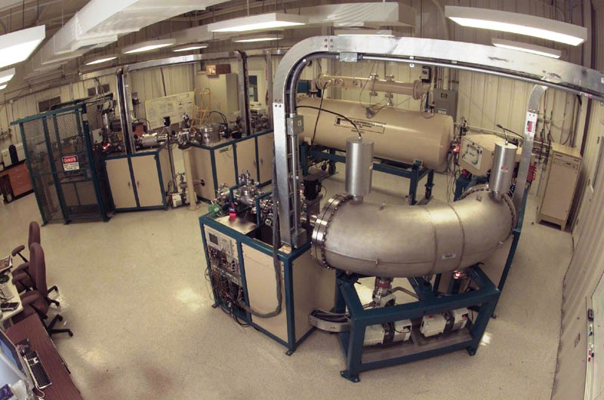
Dates?
Bce/CE or BC/AD
Most well known
Usually useful for historical record comparison
BP
Years “Before Present”
Present = 1950
Radiocarbon dating
YA
“Years Ago”
Used mostly in geology
For very long segments of time
Accelerated Mass Spectrometer (used for Radiocarbon dating)
Notes:
Archaeologists like to look at time, but how do we tell time? We can use lots of different arbitrary divisions of time, like the number of revolutions the moon makes around the Earth, or how many times Jupiter orbits the sun. For our purposes, we use the number of Earth orbits around the sun (a solar year). In archaeology, there are three main time units commonly used: BCE/CE (or BC/AD), BP, and YA. Each of them has a specific use and purpose within archaeological reporting.

Slide 5
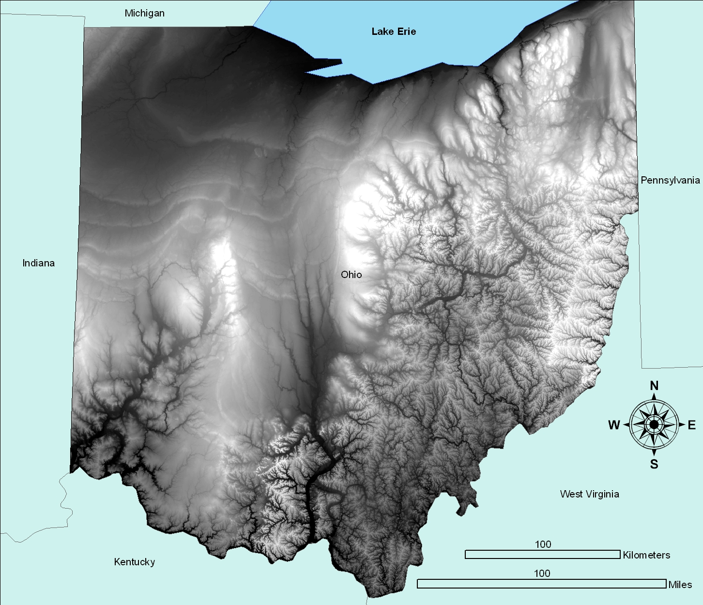
When?
Moraines
- Maximum extent of glaciation
- Land north of moraines under ice at one point
Glacial Till
- Sediments deposited by glaciers
Non-Local Rocks
- Slates and granites from Canada
Notes:
Let’s focus on just Ohio for a moment. We can see from this topographic (or relief) map that glaciers came in “waves” and smoothed out portions of Ohio. Noticed the Northwestern portion of Ohio, and you can see lines of elevation. These are glacial moraines, or areas where the glaciers stopped expanding, began to melt, and deposited sediments that they had picked up while they “moved” south. The sediments deposited by glaciers formed what we today call “glacial till,” or a combination of sediments and rocks from other geographic regions. This is why in some parts of Ohio, you can find rocks that actually outcrop in Canada in the ground, like granite and slate.

Slide 6
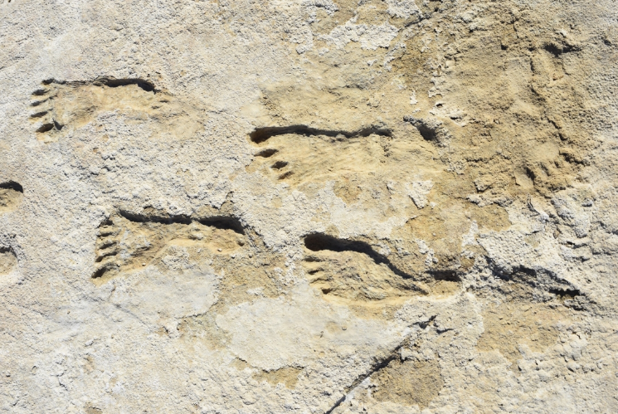
When?
Meadowcroft, PA
Radiocarbon dated to over 20,000 years ago
White Sands, NM
Fossilized footprints over 23,000 years old
Notes:
For decades, most archaeologists were content with the interpretation that humans first arrived in North America roughly 14,000 years ago crossing the Beringia land bridge and walking through ice corridors. However, there are a plethora of sites in North and South America that push the earliest dates of human occupation further back in time.

Slide 7
When?
Pre-Clovis
Clovis
Who?
Earliest humans in North America, crossing Beringia. Crude stone tool technology.
First discovered in 1930s in…Clovis, NM. Known for their distinct fluted lanceolate projectiles. Sophisticated toolkits for high mobility (14,000 to 10,000 BP)
Solutrean “Hypothesis”
Speculative claim that Europeans sailed to America during Solutrean period (22 – 17,000 BP). Rejected by professional archaeologists.
Notes:
We do not know what these earliest peoples would have called themselves, or exactly what language they spoke. What we can say is that these people lived in small bands, likely not exceeding 50 people, and traveled great distances by foot. Pre-Clovis cultures were explorers, but left very little materials behind, and the materials that did survive are very crude compared to the later Clovis people. Clovis people are named after the site of the first discovery in Clovis, NM (which you can visit today, called Blackwater Draw just south of Clovis). These earliest peoples were thought to be the first settlers of the Americas because they had developed a complex toolkit designed for long distance exploration, including bladelets, burins, and the clovis point.

Slide 8
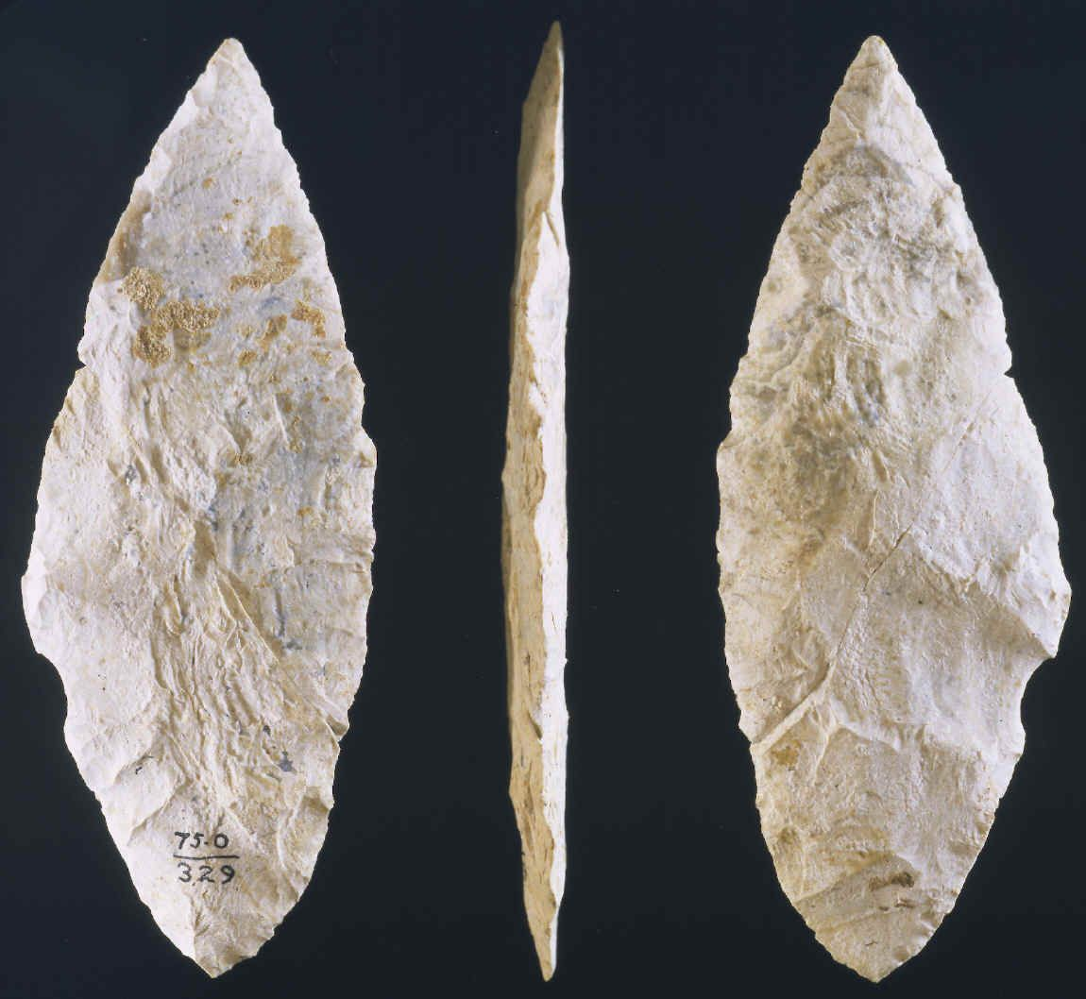
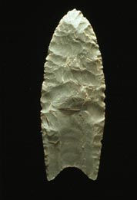
Solutrean?
Poor science
Based on similarity of stone tools
First published in New York Times, not a peer-reviewed publication
Assumes boats were invented
Ignores radiocarbon data
Clovis fluted point
Solutrean projectile point
Notes:
The Solutrean “hypothesis” is loosely based on the manufacturing similarities of Solutrean project points in Europe, and those of Clovis points in North America. The “hypothesis” has been flatly rejected by all archaeologists worth their salt, but
for a brief overview of why this “hypothesis” is nothing more than a new spin on a long tradition of racist archaeology, read Jennifer Raff’s 2018 article in the Guardian: https://www.theguardian.com/science/2018/feb/21/rejecting-the-solutrean-hypothesis-the-first-peoples-in-the-americas-were-not-from-Europe. Genetic sequencing clearly demonstrates that the earliest humans in North America came from Beringia.

Slide 9
Who?
MegaFauna
“Paleo Diet”
When?
Mammoths, mastodons, and giant sloths, oh my!
But also: ducks, geese, groundhogs, deer, elk, black bear
Wishful imagining of the past by medical professionals and health gurus.
Subsistence?
Plants?
Nuts, fruits, other plant resources
Paleoindian subsistence was not this ->
Notes:
Contrary to the popular narrative of “man the hunter,” people in the Paleoindian period were not eating mammoth for dinner every night around the campfire. These “ice age giants” were more likely threats to human survival than meat to be hunted. Sites like Meadowcroft Rock shelter provide a wealth of plant and animal remains that demonstrate the earliest humans in North America did not usually eat these large megafauna.

Slide 10
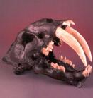
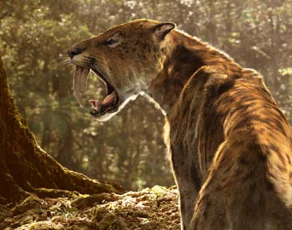
Sabertooth
MegaFauna
Threat to human survival, not an easy meal
Notes:
One of the first interpretations by archaeologists in the early 20th century was the “hunter extinction” hypothesis. Most early archaeologists assumed humans overhunted the megafauna, causing their extinction. Really, the end of the ice age caused their extinction. Large, furry mammals simply had no ability to rapidly adapt to the relatively warm environment of North America after the ice melted. Likewise, such large megafauna would have been difficult to hunt, and highly risky both from their reliability of securing calories and in the risk to life in the pursuit of those calories.

Slide 11
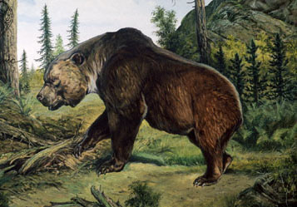
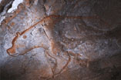
Short Faced bear
Threat, but also food?
Notes:
We know from later archaeological cultures that bears played an important role in jewelry, rituals, and in subsistence. For subsistence, bear fat represented one of the only sources of reliable fat for seasoning foods, since most other game in North America was lean or had lower quality fats (e.g. deer, elk, rabbit). Bear fat was the “butter” of North America.

Slide 12
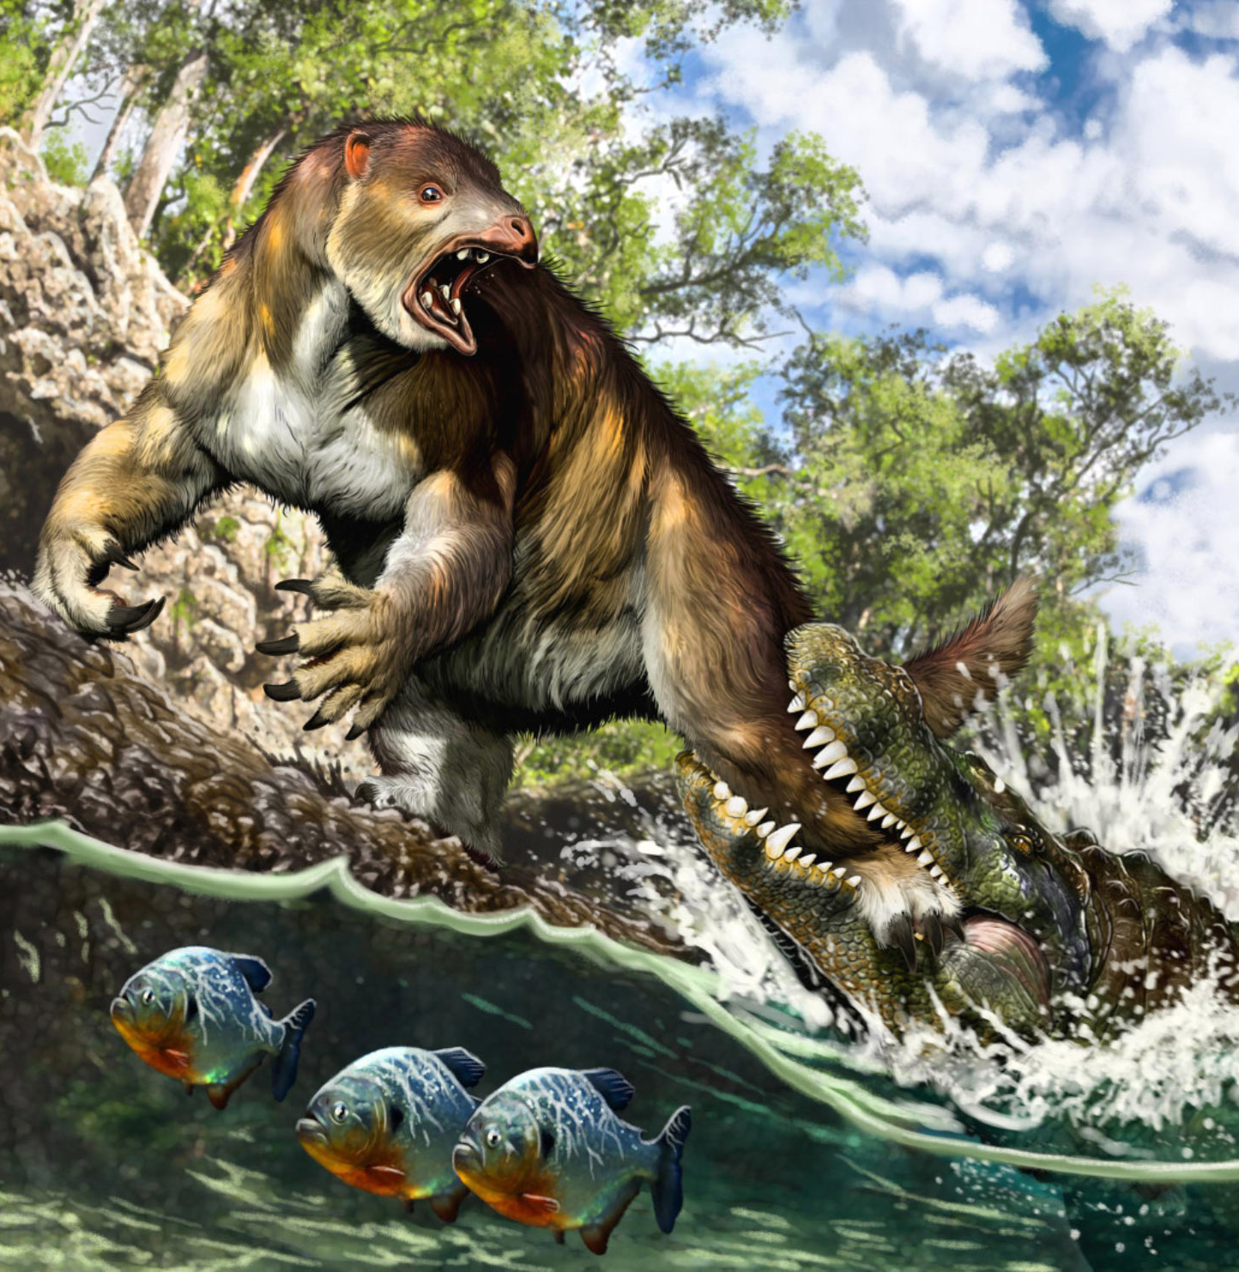
Giant Sloth
No known human butchering/hunting
Notes:
Several sloths have been found in Ohio, but there is no evidence to date that humans hunted or butchered them for their meat.

Slide 13
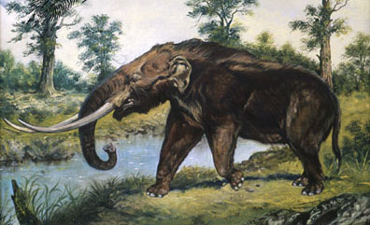
American Mastodon
Most famous megafauna
Butchered, no clear evidence hunted
Notes:
Mastodon sites are the most commonly found “megafauna” kill sites in Ohio. However, don’t take “most common” to mean they were abundant. Most mastodon sites can only tentatively associate human activity, and only in a handful of cases has evidence. Now, if you wanted to find just mastodons in the state, there are hundreds of mastodon sites, often preserved in bogs where their immense weight caused them to get stuck and starve to death, and the anaerobic conditions preserved their skeletons for thousands of years.

Slide 14
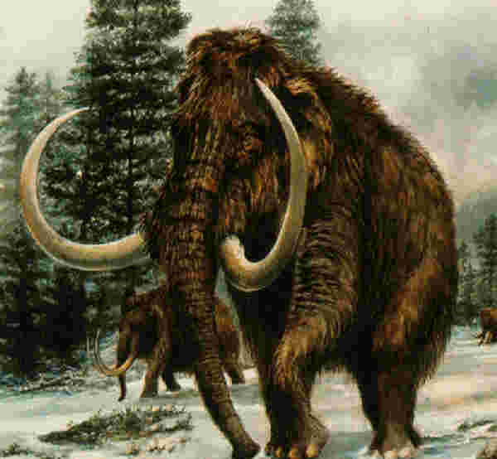
Wooly Mammoth
Outnumbered by Mastodon 3:1
Notes:
Mammoths are less commonly found in Ohio, and to date none have been directly associated with human activity or linked to hunting by humans.

Slide 15
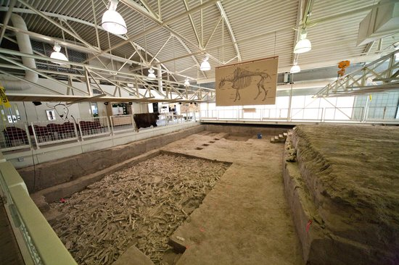
Bison
Hudson-Meng Bison Kill Site, Nebraska
Notes:
Bison were a commonly hunted food source in North America. However, due to their herd behavior and large numbers, Bison were not always hunted like they were depicted in film and tv. Without horses, dogs and strategically placed hunters would be able to funnel bison to cliffs for large “kill sites.” Practically speaking, these locations are not as common as mass herd deaths due to wildfires, flash floods, or getting trapped in swamps. Hudson-Meng is a classic example of the complexities of archaeological sites, and the interpretation of the site as a “kill site” has been revised over the years to likely a site that humans either had no involvement with, or scavenged for remnants after a mass death from a flash flood that killed the bison who had sought shelter from a wildfire.

Slide 16
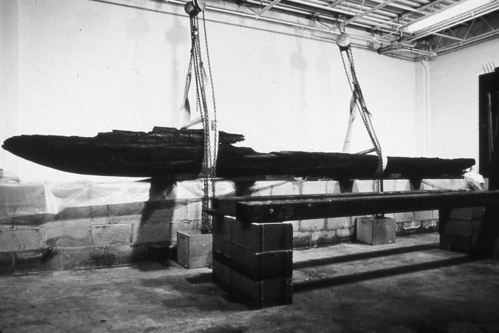
Technology?
Stone Tools
Do not decompose, and often represent the only evidence of human behavior
Organic materials
Things made out of wood, bone, hide, or plant decay without any material evidence.
Boats?
Most made of organic material, but can we determine if they had boats indirectly?
Ringler Dugout canoe from Savannah Lake, Ohio
Notes:
The Ringler dugout is one of a handful of canoes found in Ohio. Most canoes in the eastern U.S. have been found in Florida and the Carolinas, in waterlogged swamps or lakes. Most Florida and Carolina dugout canoes date to the Late Archaic period, while the Ohio canoes have evidence of Late Precontact manufacture (evidence of steel tools used in their creation). Other studies, such as Juliet Morrow’s 2014 study of stone tool distribution, demonstrates that Paleoindian people did not have the capability of crossing the Mississippi in watercraft during this time.

Slide 17
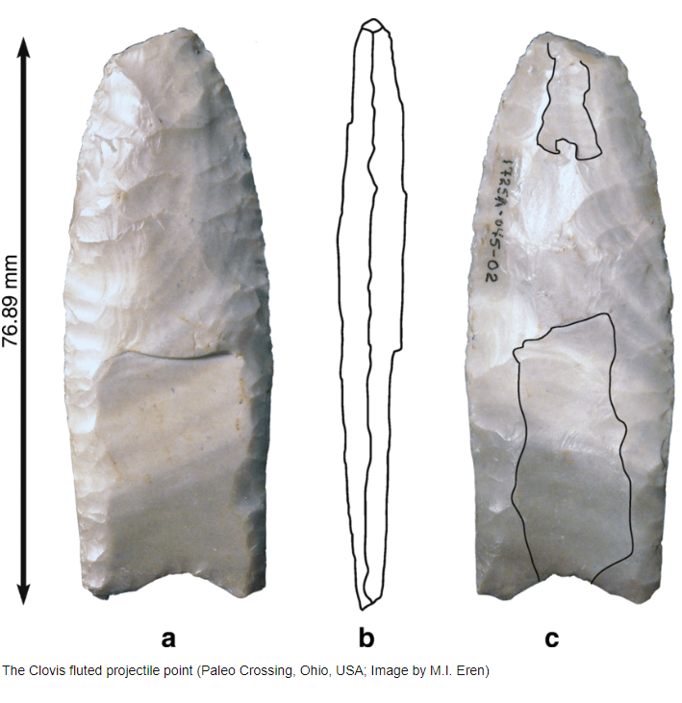
Technology?
Projectile Points
Not arrowheads, but likely projectiles on spears or darts. Could also be multifunctional knives, puncture tools, saws, etc.
Notes:
The primary reason arcaheologists call most stone tools projectile points is because we cannot say for certain in most cases (unless microwear analysis is conducted) that stone tools were used as dart points, spear points, or knives. The clovis point has been colloquially called the “Boy Scout knife” of the time, since its long blade provided ample space for slicing, sawing, and cutting, while the resharpened tip could be reused for puncturing many times without fail. Reusability was vital to people traveling thousands of kilometers a year, and often were hundreds of kilometers from the nearest stone tool source.

Slide 18
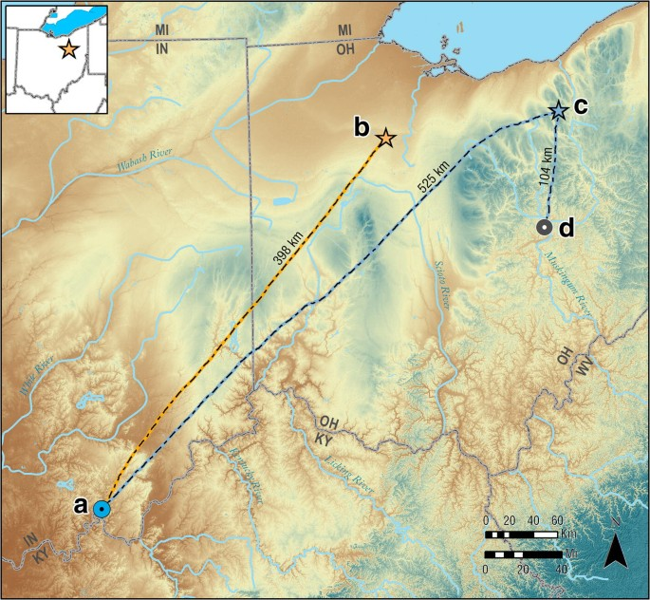
Paleo-Crossing Site
“500 miles”
Lots and lots of walking part of Paleoindian life
Wyandotte chert carried hundreds of kilometers
Notes:
Paleo-crossing, also known as the Remington Site, is located in Sharon Township, Medina County, Ohio. The site contains stone tools sourced to the Wyandotte outcrop in southern Indiana. From what we know of Paleoindian travel, this material would have been carried, by foot, hundreds of kilometers to the site. This site has provided a wealth of information about how Paleoindian people curated their tools for such long journeys that were made year-round.

Slide 19
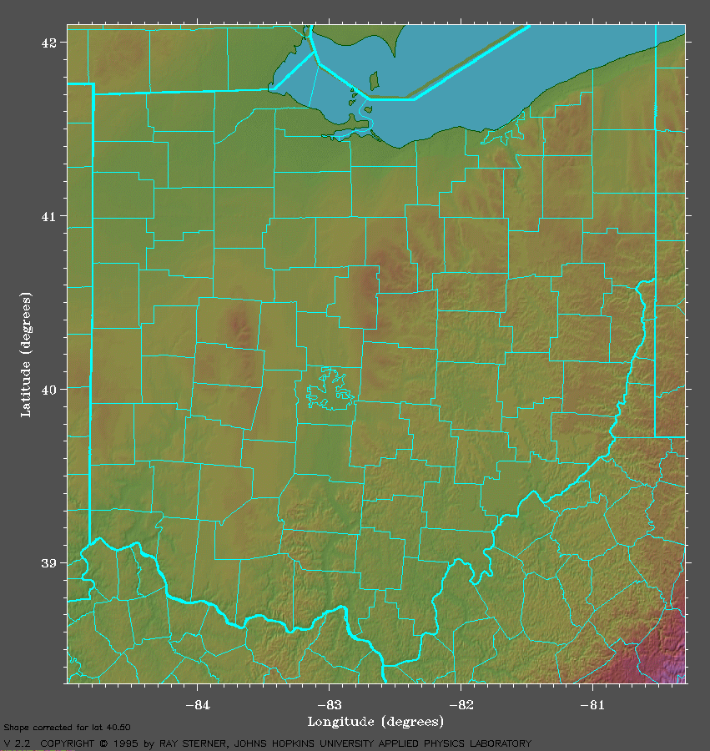
Population?
Long Distance Walkers
Recent demographic estimates put about 500 people living in Ohio during the Clovis portion of the Paleoindian
Paleoindian Database of America
(PIDBA)
Notes:
https://pidba.utk.edu/ohio.htm. The link to PIDBA provides basic information about the locations of projectile points and sites of the earliest humans in North and South America. The database is one of the oldest digital databases for archaeology, and contains various levels of provenience information.

